Slide 1



Analyzing Agriculture Productivity Across Indian States

Slide 2

Learning Objectives
Understand how to use Power BI for data visualization in the agriculture sector.
Analyze regional productivity trends and crop-wise performance.
Draw insights to identify low-performing regions or crops.
Demonstrate interactive dashboards for better decision-making.
GOAL
Source :
www.freepik.com/

Slide 3
Tools and Technology used
Power BI: For data modeling, dashboard creation, and visual analysis
Excel/CSV Data: Source files for input data

Slide 4
Methodology
1. Data Import – Loaded agricultural dataset into Power BI.
2. Data Modeling – Established relationships between tables.
3. Visualization – Created charts for crop productivity, regional yield comparison, etc.
4. Dashboard – Designed a report with slicers and KPIs.

Slide 5
Problem Statement:
Farmers and policymakers lack easy access to visual insights into agricultural productivity trends across various regions and crops, which limits efficient decision-making.

Slide 6
Solution:
Developed an interactive Power BI dashboard that:
Visualizes region-wise and crop-wise productivity.
Highlights top and bottom-performing areas.
Helps in strategic planning and resource allocation.

Slide 7
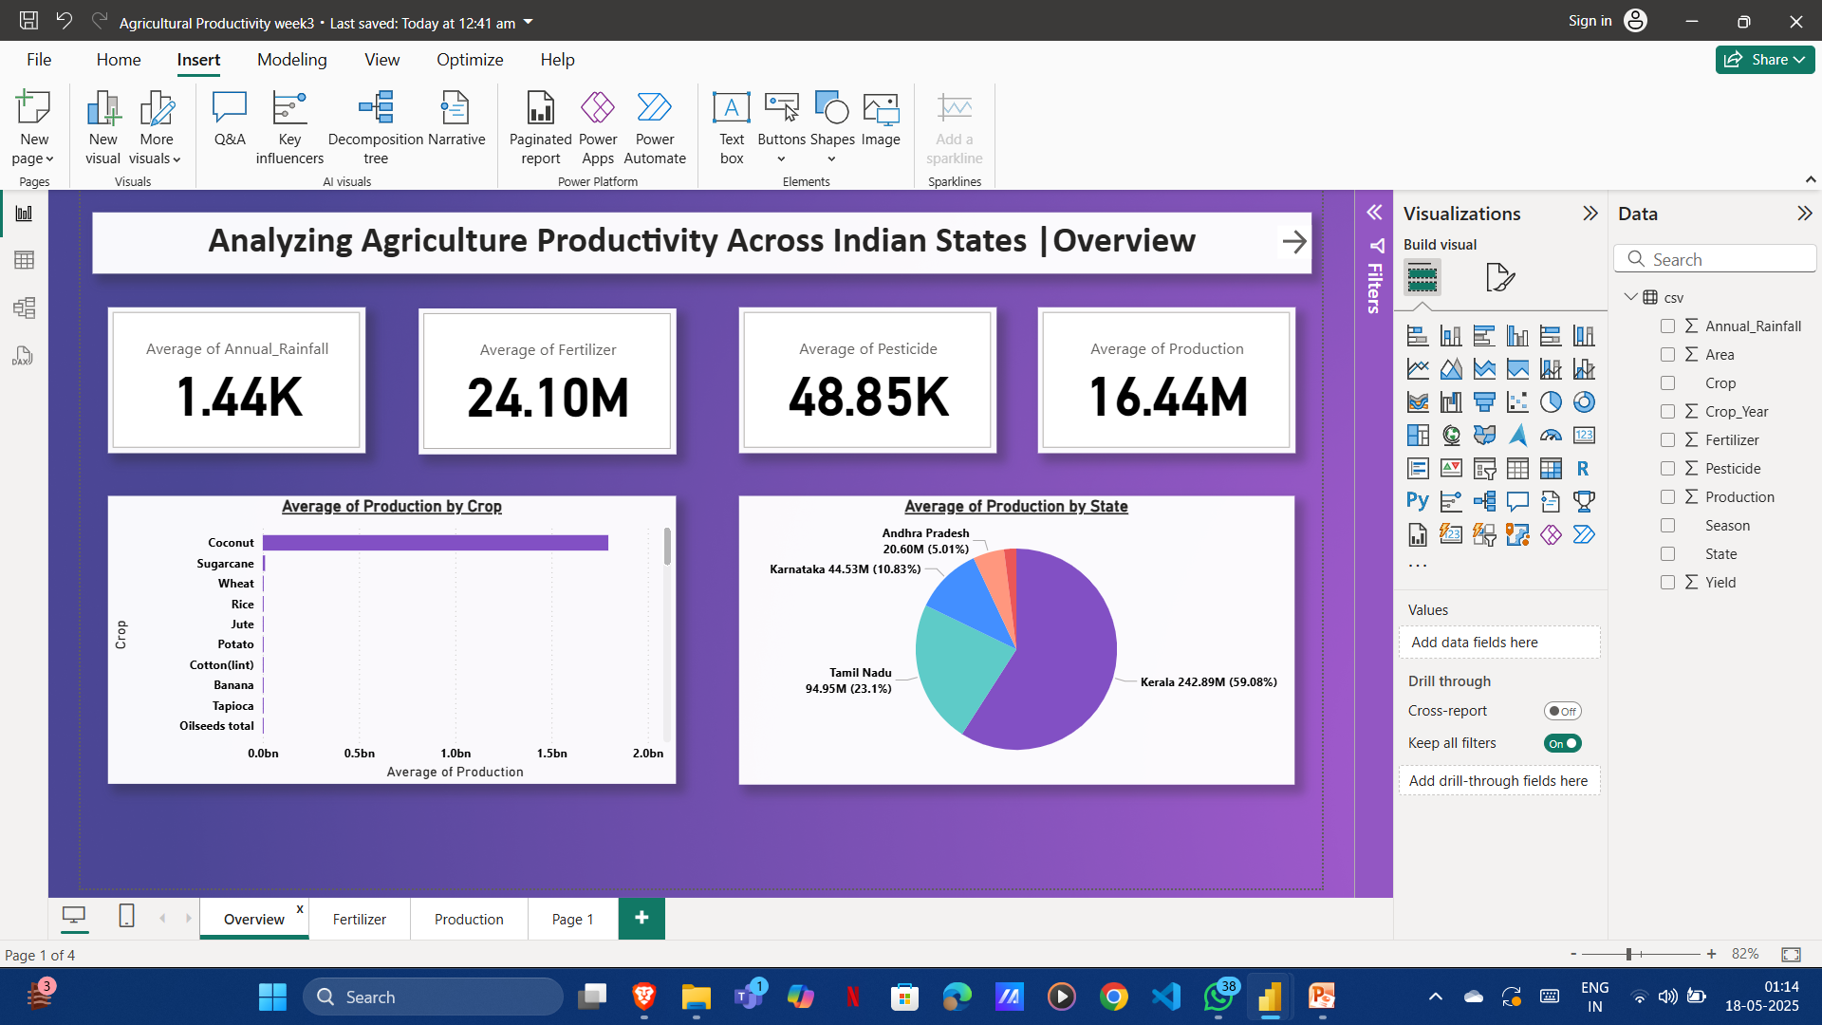
Screenshot of Output:

Slide 8
Conclusion:
The project demonstrates the power of visualization tools like Power BI in transforming raw agricultural data into meaningful insights. It supports better planning and decision-making in the agricultural sector by identifying trends, inefficiencies, and opportunities.

Slide 9
Thank You

